Slide 1
CS35L – F16
Slide set: | 3.1
Slide topics: | Diff, modifying programs
Assignment: | 3

Slide 2
Assignment 10
Deadline to sign up is this Friday (10/14/2016) at 11:55pm
Sign up link is found on CCLE Site Info page – Lab 3 (Aishwarya Kamal) Assignment 10 sign up
Assignment 10 sign up link
Choose a topic and presentation time slot
Read the article, write a report on it, create a slide presentation
Presentation should be “for dummies!”

Slide 3
How to Install Software
Windows
Installshield
Microsoft/Windows Installer
OS X
Drag and drop from .dmg mount -> Applications folder
Linux
rpm(Redhat Package Management)
RedHat Linux (.rpm)
apt-get(Advanced Package Tool)
Debian Linux, Ubuntu Linux (.deb)
Good old build process
configure, make, make install

Slide 4
Decompressing Files
Generally, you receive Linux software in the tarball format (.tgz) or (.gz)
Decompress file in current directory:
$ tar –xzvf filename.tar.gz
Option –x: --extract
Option –z: --gzip
Option –v: --verbose
Option –f: --file

Slide 5
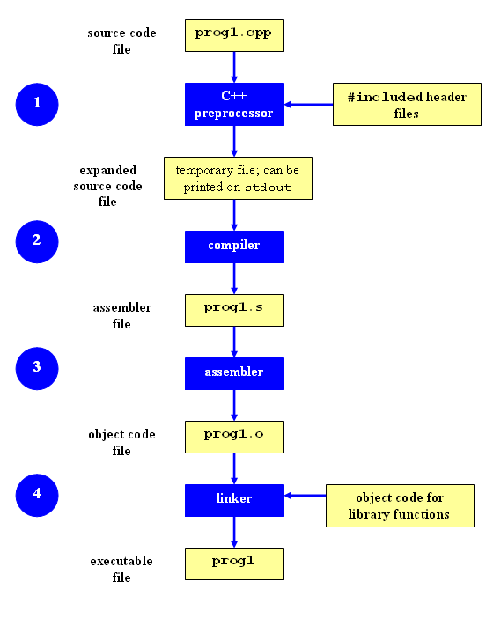
Compilation Process
Compilation

Slide 6
Command-Line Compilation
shop.cpp
#includes shoppingList.h and item.h
shoppingList.cpp
#includes shoppingList.h
item.cpp
#includes item.h
How to compile?
g++ -Wall shoppingList.cpp item.cpp shop.cpp –o shop

Slide 7
What if…
We change one of the header or source files?
Rerun command to generate new executable
We only made a small change to item.cpp?
not efficient to recompile shoppinglist.cpp and shop.cpp
Solution: avoid waste by producing a separate object code file for each source file
g++ -Wall –c item.cpp… (for each source file)
g++ item.o shoppingList.o shop.o –o shop (combine)
Less work for compiler, saves time but more commands

Slide 8
What if…
We change item.h?
Need to recompile every source file that includes it & every source file that includes a header that includes it. Here: item.cpp and shop.cpp
Difficult to keep track of files when project is large
Windows 7 ~40 million lines of code
Google ~2 billion lines of code
=> Make

Slide 9
Make
Utility for managing large software projects
Compiles files and keeps them up-to-date
Efficient Compilation (only files that need to be recompiled)

Slide 10
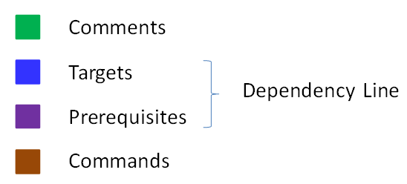
Makefile Example
# Makefile - A Basic Example
all : shop #usually first
shop : item.o shoppingList.o shop.o
g++ -g -Wall -o shop item.o shoppingList.o shop.o
item.o : item.cpp item.h
g++ -g -Wall -c item.cpp
shoppingList.o : shoppingList.cpp shoppingList.h
g++ -g -Wall -c shoppingList.cpp
shop.o : shop.cpp item.h shoppingList.h
g++ -g -Wall -c shop.cpp
clean :
rm -f item.o shoppingList.o shop.o shop
Rule

Slide 11
Build Process
configure
Script that checks details about the machine before installation
Dependency between packages
Creates ‘Makefile’
make
Requires ‘Makefile’ to run
Compiles all the program code and creates executables in current temporary directory
make install
make utility searches for a label named install within the Makefile, and executes only that section of it
executables are copied into the final directories (system directories)

Slide 12
Lab 3
Coreutils 7.6 has a problem
Different users see different date formats
$ ls –l /bin/bash
-rwxr-xr-x 1 root root 729040 2009-03-02 06:22 /bin/bash
-rwxr-xr-x 1 root root 729040 Mar 2 2009 /bin/bash
Why?
Different locales
Want the traditional Unix format for all users
Fix the ls program

Slide 13
Getting Set Up (Step 1)
Download coreutils-7.6 to your home directory
Use ‘wget’
Untar and Unzip it
tar –xzvf coreutils-7.6.tar.gz
Make a directory ~/coreutilsInstall in your home directory (this is where you’ll be installing coreutils)
mkdir coreutilsInstall

Slide 14
Building coreutils (Step 2)
Go into coreutils-7.6 directory. This is what you just unzipped.
Read the INSTALL file on how to configure “make”, especially --prefix flag
Run the configure script using the prefix flag so that when everything is done, coreutils will be installed in the directory ~/coreutilsInstall
Compile it: make
Install it: make install (won’t work on Linux server without proper prefix!)
Why?

Slide 15
Reproduce Bug (Step 3)
Reproduce the bug by running the version of ‘ls’ in coreutils 7.6
If you just type $ ls at CLI it won’t run ‘ls’ in coreutils 7.6
Why? Shell looks for /bin/ls
To use coreutils 7.6: $ ./ls
This manually runs the executable in this directory

Slide 16
Patching
A patch is a piece of software designed to fix problems with or update a computer program
It’s a diff file that includes the changes made to a file
A person who has the original (buggy) file can use the patch command with the diff file to add the changes to their original file

Slide 17
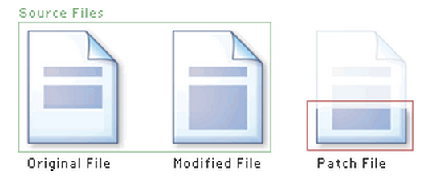
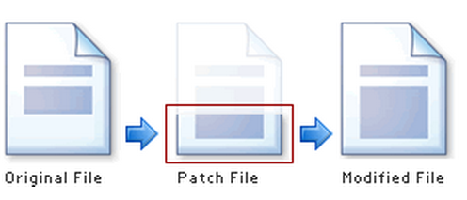
Applying a Patch

Slide 18
diff Unified Format
diff –u original_file modified_file
--- path/to/original_file
+++ path/to/modified_file
@@ -l,s +l,s @@
@@: beginning of a hunk
l: beginning line number
s: number of lines the change hunk applies to for each file
A line with a:
- sign was deleted from the original
+ sign was added to the original
stayed the same

Slide 19
Patching and Building (Steps 4 & 5)
cd coreutils-7.6
vim or emacs patch_file: copy and paste the patch content
patch –pnum < patch_file
‘man patch’ to find out what pnum does and how to use it
cd into the coreutils-7.6 directory and type make to rebuild patched ls.c.
Don’t install!!

Slide 20
Testing Fix (Step 6)
Test the following:
Modified ls works
Installed unmodified ls does NOT work
Test on:
1) a file that has been recently modified
Make a change to an existing file or create a new file
2) a file that is at least a year old
touch –t 201401210959.30 test_file
Answer Q1 and Q2

Slide 21
Homework 3
comm.py

Slide 22
Homework 3
comm.py – this should end up working almost exactly like the utility ‘comm’
Check $ man comm for extensive documentation
Extra option –u
Means input files are not required to be pre-sorted
Could sort them, but then have to maintain original ordering
Other ways to accomplish this?

Slide 23
Homework 3
Use randline.py as a starting point!
Modify to accomplish logical task of comm
Comm C source code will be posted on CCLE - Lab 3 materials
This will give you an idea of the logic behind the operation that comm executes
Python OptionParser link will be posted on CCLE - Lab 3 materials
How to add your own options to the parser
-1 -2 –u etc

